Slide 1
Object-Oriented Programming
Mohammad Salman
Dean’s Fellow

Slide 2
The this Pointer
It’s hidden from you (kind of). You can use it explicitly if you want to though.
https://www.learncpp.com/cpp-tutorial/the-hidden-this-pointer-and-member-function-chaining/

Slide 3
How does the compiler interprets member function calls?
We have already seen this before actually.
Let’s take the Complex numbers example from your lab.

Slide 4
How does the compiler interprets member function calls?
Recall that you had a member function (or method) call like so.
c1 and c2 were two Complex type objects in your program.
c1.add(c2);
Compiler interprets the above as follows.
Complex::add(&c1, c2);
c1 is now being passed (implicitly) by address to the function.

Slide 5
How does the compiler interprets member function calls?
Note, however, that your member function looks like as follows.
It only has a single argument.
Whereas the compiler is now passing two arguments.
Complex Complex::add(Complex c2)
{
Complex c3;
c3.m_real = m_real + c2.m_real;
c3.m_imag = m_imag + c2.m_imag;
return c3;
}
// Compiler’s interpretation
add(&c1, c2);

Slide 6
How does the compiler interprets member function calls?
The compiler also updates your member function as shown.
c1.add(c2);
Complex Complex::add(Complex* const this, Complex c2)
{
Complex c3;
c3.m_real = this->m_real + c2.m_real;
c3.m_imag = this->m_imag + c2.m_imag;
return c3;
}
Compiler’s interpretation
add(&c1, c2);

Slide 7
Pointer to an int
Pointer to a pointer to an int
int* ptr
int** ptr
Read from right to left
Read from right to left
Note
You can replace int with any built-in data type and class types.
const pointer to an int
int* const ptr
const pointer to a const int
Read from right to left
const int* const ptr
Pointer to a const int
Read from right to left
const int* ptr
Read from right to left
Notes:
Let’s see what each of these three types of const-ness imply.

Slide 8
What do these pointers mean?
Two dimensions
Can the pointer be changed?
Can the pointed data be changed?
int* const ptr (const pointer to an int)
The value of the pointer cannot be changed (cannot point at anything else).
However the entity to which it is pointing at can be changed.
const int* ptr (pointer to a const int)
The value of the pointer itself can be changed (can be made to point at something else).
The value of the entity to which the pointer is pointing at, could not be changed.
const int* const ptr (const pointer to a const int)
Neither the entity nor the pointer can be changed.
Notes:
Now let’s try to identify which one is this pointer?

Slide 9
Complex Complex::add(Complex c2)
{
Complex c3;
// c3.m_real = this->m_real + c2.m_real;
// c3.m_imag = this->m_imag + c2.m_imag;
this = nullptr;
this = &c2;
return c3;
}
c1.add(c2);
Compiler’s interpretation
add(&c1, c2);
Complex* const this
&c1
Complex c1
double m_real | double m_imag
// Methods
Complex c2
double m_real | double m_imag
// Methods
Complex c3
double m_real | double m_imag
// Methods
Both of these objects were created in main().
c3 would be created, and be local to add().

Slide 10
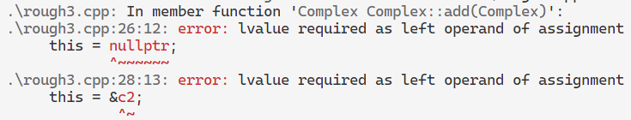
Complex Complex::add(Complex c2)
{
Complex c3;
// c3.m_real = this->m_real + c2.m_real;
// c3.m_imag = this->m_imag + c2.m_imag;
this = nullptr;
this = &c2;
return c3;
}
c1.add(c2);
Compiler’s interpretation
add(&c1, c2);
Neither of these is allowed because this is a const pointer to object; its value cannot be changed.
Note
We haven’t talked about lvalues and rvalues in this course.
In simple terms, you can think of lvalue as a variable.

Slide 11
Pointer to an int
Pointer to a pointer to an int
int* ptr
int** ptr
Read from right to left
Read from right to left
This one is the this pointer.
const pointer to an int
int* const ptr
const pointer to a const int
Read from right to left
const int* const ptr
Pointer to a const int
Read from right to left
const int* ptr
Read from right to left

Slide 12
The hidden “this” pointer
Note that this this pointer is a const pointer.
This means that you cannot change this’s value.
It can only point to the implicit object.
You cannot change its value (not even to nullptr).
You can change the attributes of the entity to which it is pointing at (which is the implicit object).
Complex Complex::add(Complex* const this, Complex c2)

Slide 13
The hidden “this” pointer
this pointer will always be the leftmost parameter.
Complex Complex::add(Complex* const this, Complex c2)

Slide 14
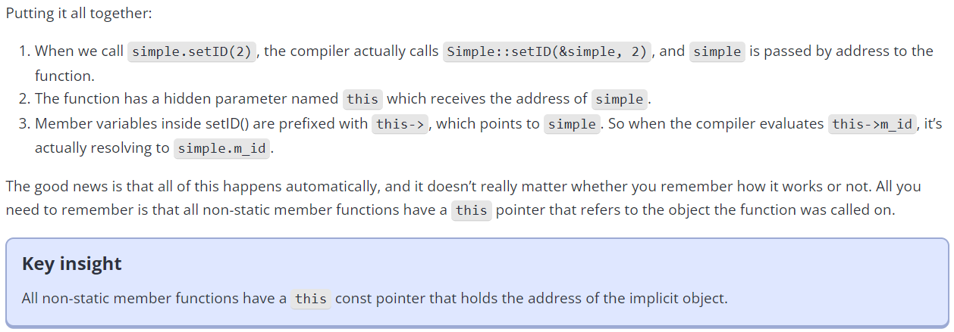
In learncpp, they’ve created class Simple, and instantiated an object of this class, Simple simple.
Note
The members we have seen thus far are non-static members. We haven’t talked about static members yet.
Notes:
Maybe write out what it says here in terms of Complex.

Slide 15
#include<iostream>
class A
{
private:
int m_num1;
public:
A() : m_num1{ 0 } {}
int getNum1() const
{
this->m_num1 = 5;
return this->m_num1; // same as "return m_num1;"
}
};
int main()
{
A ob;
ob.getNum1();
return 0;
}
Self Study
Is this program valid?
Notes:
this pointer is now
“int const* const this”

Slide 16
Some use-cases of this
First up, is Method Chaining

Slide 17
The following will work.
What will be the output?
8
This is somewhat of a hassle; three lines.
How could we do something like so?
calc.add(5).sub(3).mult(4);
Can I do this chaining right now btw?
class Calc
{
private:
int m_value;
public:
Calc() : m_value{ 0 } {}
void add(int value) { m_value += value; }
void sub(int value) { m_value -= value; }
void mult(int value) { m_value *= value; }
int getValue() const { return m_value; }
};
int main()
{
Calc calc{};
calc.add(5); // returns void
calc.sub(3); // returns void
calc.mult(4); // returns void
std::cout << calc.getValue() << '\n';
return 0;
}

Slide 18
We can’t have the functions as void, otherwise chaining won’t work.
Something has to be returned.
We can return by reference.
class Calc
{
private:
int m_value{};
public:
Calc() : m_value{ 0 } {}
Calc& add(int value) { m_value += value; return *this; }
Calc& sub(int value) { m_value -= value; return *this; }
Calc& mult(int value) { m_value *= value; return *this; }
int getValue() const { return m_value; }
};

Slide 19
We can’t have the functions as void, otherwise chaining won’t work.
Something has to be returned.
We can return by reference.
class Calc
{
private:
int m_value{};
public:
Calc() : m_value{ 0 } {}
Calc& add(int value) { m_value += value; return *this; }
Calc& sub(int value) { m_value -= value; return *this; }
Calc& mult(int value) { m_value *= value; return *this; }
int getValue() const { return m_value; }
};

Slide 20
You go to Calc::add(). The value of the calc object changes from 0 to 5.
What gets returned?
The object, calc, itself.
calc.add(5).sub(3).mult(4);
class Calc
{
private:
int m_value{};
public:
Calc() : m_value{ 0 } {}
Calc& add(int value) { m_value += value; return *this; }
Calc& sub(int value) { m_value -= value; return *this; }
Calc& mult(int value) { m_value *= value; return *this; }
int getValue() const { return m_value; }
};

Slide 21
You go to Calc::add(). The value of the calc object changes from 0 to 5.
What gets returned?
The object, calc, itself.
calc.add(5).sub(3).mult(4);
calc
class Calc
{
private:
int m_value{};
public:
Calc() : m_value{ 0 } {}
Calc& add(int value) { m_value += value; return *this; }
Calc& sub(int value) { m_value -= value; return *this; }
Calc& mult(int value) { m_value *= value; return *this; }
int getValue() const { return m_value; }
};

Slide 22
Because calc was returned, now we can continue our evaluation.
3 will be subtracted from the current value (which is 5) to give 2.
calc will be returned again.
calc.sub(3).mult(4);
class Calc
{
private:
int m_value{};
public:
Calc() : m_value{ 0 } {}
Calc& add(int value) { m_value += value; return *this; }
Calc& sub(int value) { m_value -= value; return *this; }
Calc& mult(int value) { m_value *= value; return *this; }
int getValue() const { return m_value; }
};

Slide 23
Finally 4 gets multiplied to the current value (2) to give 8.
calc.mult(4);
class Calc
{
private:
int m_value{};
public:
Calc() : m_value{ 0 } {}
Calc& add(int value) { m_value += value; return *this; }
Calc& sub(int value) { m_value -= value; return *this; }
Calc& mult(int value) { m_value *= value; return *this; }
int getValue() const { return m_value; }
};

Slide 24
calc is returned again, but nothing happens since there are no further operations left.
calc;
class Calc
{
private:
int m_value{};
public:
Calc() : m_value{ 0 } {}
Calc& add(int value) { m_value += value; return *this; }
Calc& sub(int value) { m_value -= value; return *this; }
Calc& mult(int value) { m_value *= value; return *this; }
int getValue() const { return m_value; }
};

Slide 25
When you do calc.getValue(), you see the updated value of calc’s attribute.
We will see these concepts of method chaining and return by reference again in operator overloading.
int main()
{
Calc calc{};
// method chaining
calc.add(5).sub(3).mult(4);
std::cout << calc.getValue() << '\n';
return 0;
}
class Calc
{
private:
int m_value{};
public:
Calc() : m_value{ 0 } {}
Calc& add(int value) { m_value += value; return *this; }
Calc& sub(int value) { m_value -= value; return *this; }
Calc& mult(int value) { m_value *= value; return *this; }
int getValue() const { return m_value; }
};

Slide 26
What happens if your methods return by address?
int main()
{
Calc calc{};
calc.add(5)->sub(3)->mult(4); // method chaining
std::cout << calc.getValue() << '\n';
return 0;
}
class Calc
{
private:
int m_value{};
public:
Calc() : m_value{ 0 } {}
Calc* add(int value) { m_value += value; return this; }
Calc* sub(int value) { m_value -= value; return this; }
Calc* mult(int value) { m_value *= value; return this; }
int getValue() const { return m_value; }
};

Slide 27
What happens if your methods return by address?
int main()
{
Calc calc{};
calc.add(5)->sub(3)->mult(4); // method chaining
std::cout << calc.getValue() << '\n';
return 0;
}
class Calc
{
private:
int m_value{};
public:
Calc() : m_value{ 0 } {}
Calc* add(int value) { m_value += value; return this; }
Calc* sub(int value) { m_value -= value; return this; }
Calc* mult(int value) { m_value *= value; return this; }
int getValue() const { return m_value; }
};

Slide 28
What happens if your methods return by address?
int main()
{
Calc calc{};
calc.add(5)->sub(3)->mult(4); // method chaining
std::cout << calc.getValue() << '\n';
return 0;
}
class Calc
{
private:
int m_value{};
public:
Calc() : m_value{ 0 } {}
Calc* add(int value) { m_value += value; return this; }
Calc* sub(int value) { m_value -= value; return this; }
Calc* mult(int value) { m_value *= value; return this; }
int getValue() const { return m_value; }
};

Slide 29
What happens if your methods return by value?
What will be the output?
5
int main()
{
Calc calc{};
calc.add(5).sub(3).mult(4); // method chaining
std::cout << calc.getValue() << '\n';
return 0;
}
class Calc
{
private:
int m_value{};
public:
Calc() : m_value{ 0 } {}
Calc add(int value) { m_value += value; return *this; }
Calc sub(int value) { m_value -= value; return *this; }
Calc mult(int value) { m_value *= value; return *this; }
int getValue() const { return m_value; }
};

Slide 30
Another use-case is to guard against self-referencing
Read the following slides as self-study.

Slide 31
class A
{
private:
int m_num1;
public:
A() : m_num1{ -1 } {}
void printAddress(A* addr)
{
if(addr == this)
{
std::cout << "Value of \"this\" = "
<< addr << std::endl;
}
else
{
std::cout << "Some other object's address = "
<< addr << std::endl;
}
}
};
Self Study
Guarding against self-referencing. Good idea to probably draw the things that are happening in main().
int main()
{
A ob1;
A ob2;
A* ptr1{ &ob1 };
std::cout << "Print 1\n";
ptr1->printAddress(ptr1);
A* ptr2{ &ob1 };
std::cout << "Print 2\n";
ptr2->printAddress(ptr1);
std::cout << "Print 3\n";
ob1.printAddress(&ob1);
std::cout << "Print 4\n";
ob1.printAddress(&ob2);
std::cout << "Print 5\n";
ob2.printAddress(&ob2);
return 0;
}

